Slide 1

Susan didn’t make it to the competition this night.
The team received a bad score.

Slide 2
Intro
This course is all about working in a team, as that is how the real world works. The grading is fairly unique, so make sure you understand this PPT!
Job interviewers will want to know you understand these issues, technologies, and processes.
If a student works really hard, writes fantastic code, and does not work well in their team, they will not pass this course.
Timely, consistent attendance is required. 15% of your grade will be based on attendance. (or more positively; “You get 15 out of 100 points just for showing up!”)

Slide 3
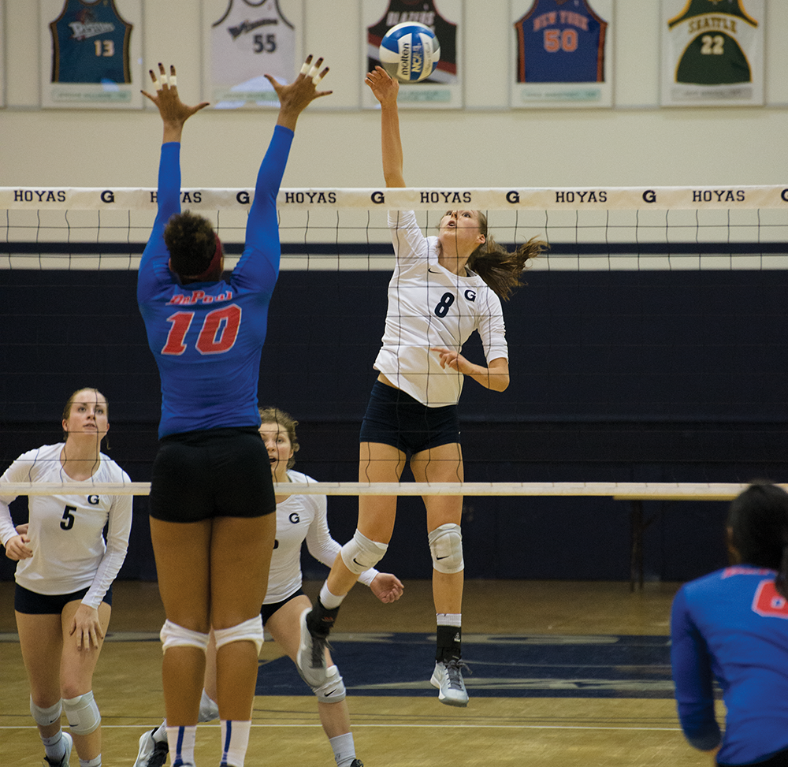
Teams cannot function well if members are absent. I will be taking attendance at 5:40 at every class.
I will allow 2 “free-passes”. But after you are late or miss 2 classes, you lose points, see next slide.
2 on 3 Volleyball?

Slide 4
15 of 100 points based on timely attendance
Join Zoom 10 or more minutes late | Points towards final grade | Highest possible grade, assuming perfect scores on all else
0-2 times | 15 | A
3-4 times | 13 | A
5-6 times | 8 | A-
7-more times | 0 | B

Slide 5
How much time you need to invest in this course:
If you look at: http://www.bellevuecollege.edu/policies/3/3050_Credit_Hours_and_Credit_Load.asp
“Credit ratios for the three basic categories of instruction are: “Lecture/discussion, 1:1—One (1) hour of lecture or classroom discussion per week and approximately two (2) additional hours of out-of-class assignments per classroom contact hour earns one (1) credit hour. For example, a five (5) credit course would equal five (5) classroom hours per week plus substantial out-of-class assignments and study time.”
So our 5 credit course should be 10 hours each week you are expected to invest in this course beyond class room time.
Many students will be able to do it in less, but if the material is not coming easily to you, you should plan on 15 hours each week.

Slide 6
This course will attempt to emulate your first job in a startup. It’s a bit less about coding and a bit more about project management and working on a shared project.
Define and document a team course project spec
Doing team source control: creating and merging branches and resolving merge conflicts.
Scrum process using Azure Dev Ops (Visual Studio Team Services) to start a project, creating a set of features and tasks, and doing weekly sprints.
Implement a basic client-server application deployed to Azure Cloud
Learning a new JS framework (Angular) and using fetch to read and write server data using a Web API interface to a cloud ASP API app which in turn accesses a mongodb cloud database

Slide 7
We will do a starter project, each team implementing their own version of the same target project.
Implement 1st SCRUM Sprint, including 1st version of Server side and client-side code
Implement more SCRUM Sprints to complete original project spec.
Then each team will start a new, unique project of their choice, and do one SCRUM cycle each week for the rest of the course
The “final exam” will be a presentation to the class of your project.

Slide 8
As a BC student, you get a free Azure student account
With a credit card, anyone can get a free Azure services, including
10 Web, mobile, or API apps
1 GB Disk space
500/ day Active mobile devices
But with our student account, you do not even have to provide a credit card.
Some of the free services include:
Azure App Service (Web Apps)
Access to Azure DevOps
The process to get a student account changes every few months, suffer through it and get your account if you don’t have one already. Start here:
https://azure.microsoft.com/en-us/free/students/

